Slide 1


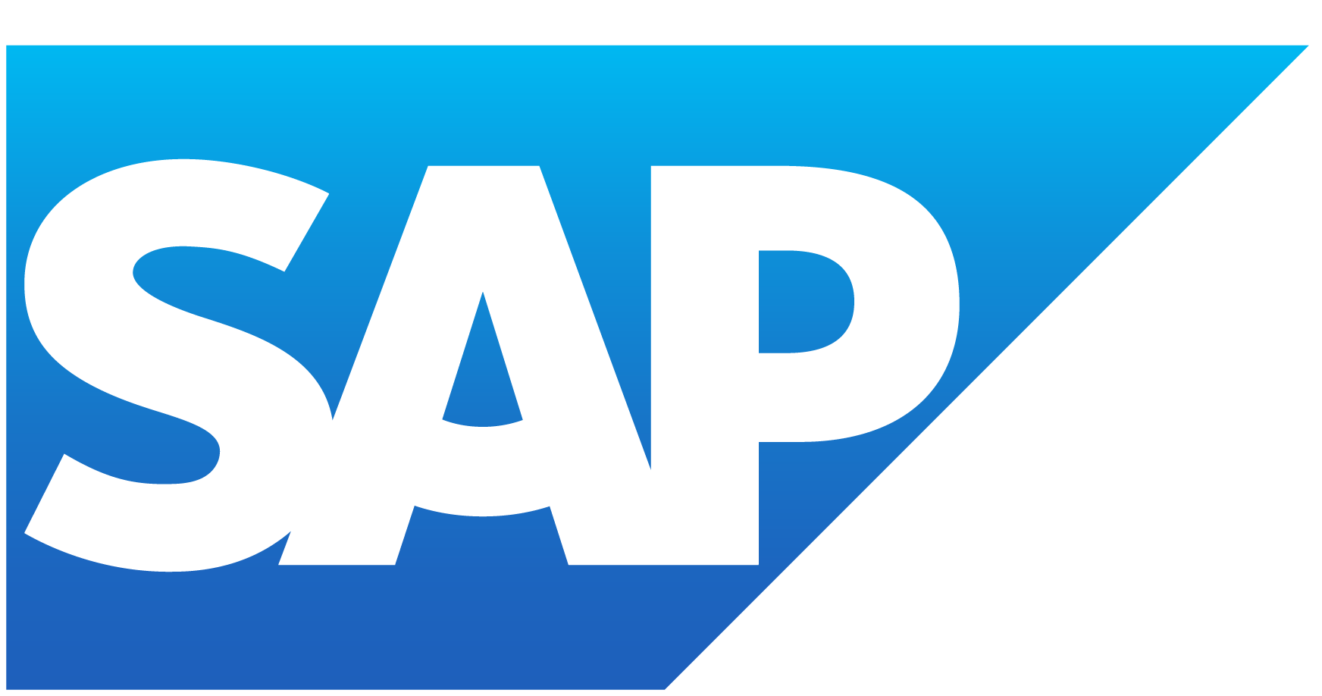


Azure App Services
Disclaimer: The content is curated for educational purposes only.
Notes:
Lets Discuss Azure App Services

Slide 2
Overview
In this module, we learn about a platform-as-a-service (PaaS) offering that allows you to host web apps. We will take an overview of Azure App services, Understand how to create an App Service plan and Deploy web applications using different deployment options. Learn how to create and configure Web Apps, manage deployment slots, and use deployment options like Git, FTP etc.
Notes:
In this module, we learn about a platform-as-a-service (PaaS) offering that allows you to host web apps. We will take an overview of Azure App services, Understand how to create an App Service plan and Deploy web applications using different deployment options. Learn how to create and configure Web Apps, manage deployment slots, and use deployment options like Git, FTP etc.

Slide 3

Learning Objectives
You will learn in this lesson:
Understanding Platform as a Service (Paas) Model​
Identify Common PaaS scenarios​
What are Azure App services?
How and where Azure App services are used?
Deploy App services in Linux and Windows
Azure app service Plans user can subscribe to.
How to Deploy to app service?
Notes:
Larning Objectives
You will learn in this lesson:
Understanding Platform as a Service (Paas) Model​
Identify Common PaaS scenarios​
What are Azure App services?
How and where Azure App services are used?
Deploy App services in Linux and Windows
Azure app service Plans user can subscribe to.
How to Deploy to app service?

Slide 4
Fully Managed Services PaaS & SaaS
Common PaaS Scenarios
Development Framework
Analytics or business intelligence (BI)
Notes:
Let us see some common scenarios where we can use platform as a service.
Platform as a service for development Framework –
Platform as a service lets developers create applications using built-in software components. Cloud features such as scalability, high-availability, and multi-tenant capability are included, reducing the amount of coding that developers must do.
2. Analytics or business intelligence –
Business Intelligence tools provided as a service with PaaS lets organizations to analyze their data, find insights and predict outcomes to take most suited business decisions. Tools provided as a service with PaaS allow organizations to analyses and mine their data, finding insights and patterns and predicting outcomes to improve forecasting, product design decisions, investment returns and other business decisions.

Slide 5
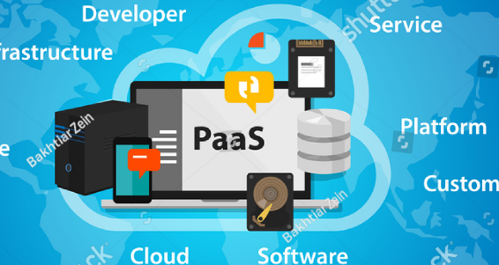
Fully Managed Services PaaS & SaaS
Introduction
Platform as a service (PaaS) is a complete development and deployment environment in the cloud, with resources that enable you to deliver everything from simple cloud-based apps to sophisticated, cloud-enabled enterprise applications.
Notes:
Platform as a Service is a complete development and deployment environment in the cloud. It provides a framework for developers upon which they can build/ develop or customize cloud-based applications.
When we use Platform as a service, we get a complete development environment without the headache of maintaining all the development infrastructure.
Examples of Azure's platform as a service are Azure App Services, Azure SQL database.

Slide 6
Fully Managed Services PaaS & SaaS
Introduction
Software as a service (SaaS) allows users to connect to and use cloud-based apps over the Internet.
SaaS provides a complete software solution which you purchase on a pay-as-you-go basis from a cloud service provider.
Notes:
Software as a service (SaaS) is the most complete cloud service model from a product perspective.
As the entire model is managed by cloud service provider, as a user the organization has least flexibility.
But it is easiest to set up and get running, and requires minimal technical knowledge and expertise to employ.
Some common examples of software as a service are - Outlook email, calendar, and office tools (such as Microsoft Office 365).

Slide 7
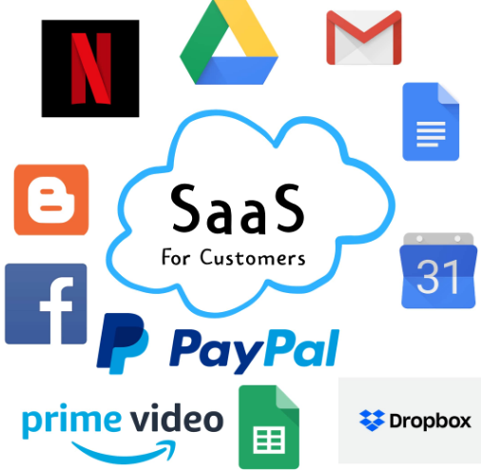
Fully Managed Services PaaS & SaaS
Common SaaS scenarios
Email and messaging.
Business productivity applications.
Finance and expense tracking.
Notes:
If you have used a web-based email service such as Outlook, Hotmail or Yahoo! Mail, then you have already used a form of SaaS.
With these services, you log into your account over the Internet, often from a web browser. You pay for the use of these apps by subscription or according to the level of use
The most common services that we all use, like Netflix, Facebook , Amazon Prime Video use Software as a service model.

Slide 8
Azure App Service is an HTTP-based service for hosting web applications, REST APIs, and mobile back ends. You can develop in your favorite language, be it .NET, .NET Core, Java, Node.js, PHP, and Python. Applications run and scale with ease on both Windows and Linux-based environments.
App Service adds the power of Microsoft Azure to your application, such as security, load balancing, autoscaling, and automated management. Additionally, you can take advantage of its DevOps capabilities, such as continuous deployment from Azure DevOps, GitHub, Docker Hub, and other sources, package management, staging environments, custom domain, and TLS/SSL certificates.
Notes:
Azure App Service is an HTTP-based service for hosting web applications, REST APIs, and mobile back ends. You can develop in your favorite language, be it .NET, .NET Core, Java, Node.js, PHP, and Python. Applications run and scale with ease on both Windows and Linux-based environments.
App Service adds the power of Microsoft Azure to your application, such as security, load balancing, autoscaling, and automated management. Additionally, you can take advantage of its DevOps capabilities, such as continuous deployment from Azure DevOps, GitHub, Docker Hub, and other sources, package management, staging environments, custom domain, and TLS/SSL certificates.

Slide 9
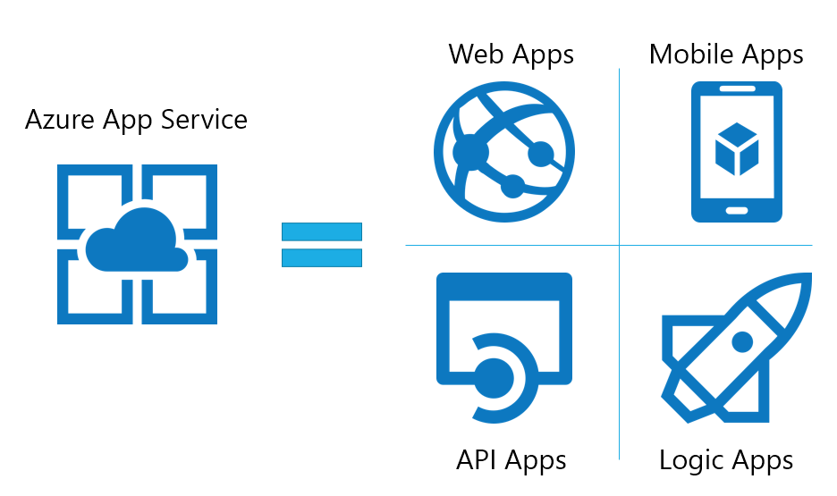
Azure App Services
Click here
Reference link
Notes:
Azure App Service is a fully managed, HTTP-based service, platform as a service (PaaS) offering for developers.
It can host web applications, REST APIs, and mobile back ends.
After completing this module, you'll be able to:
Describe Azure App Service key components and value.
Explain how Azure App Service manages authentication and authorization.
Deploy an app to App Service using Azure CLI commands.

Slide 10
Introduction
Platform as a service (PaaS) offering for developers.
HTTP-based service
Host web applications, REST APIs, and mobile back ends.
Both Windows and Linux Platforms.
Pay only for the Azure compute resources you use.
App Service plan .
Notes:
Azure App Service is an HTTP-based service for hosting web applications, REST APIs, and mobile back ends. You can develop in your favourite language, be it .NET, .NET Core, Java, Ruby, Node.js, PHP, or Python.
Depending on the usage of the web app, you can scale the resources of the underlying machine that is hosting your web app up/down . Resources include the number of cores or the amount of RAM available. Scaling out/in is the ability to increase, or decrease, the number of machine instances that are running your web app.

Slide 11




Languages Supported by Azure App Services
Node.js
ASP.NET
PHP
JAVA
PYTHON
Notes:
You can develop in your preferred language, as well as run and scale applications with ease.
With App Service, you pay only for the Azure compute resources that you use.
The compute resources you use are determined by the App Service plan that you run your apps on.
The languages supported by Azure App Services include
ASP.NET
Node.js
PHP
Java
Python
Ruby

Slide 12
WordPress
Static HTML Site
ARM template
Custom container
Multi-container app
App on Azure Arc
Some languages, like python do not have support on the windows platform.
1
The frameworks supported by Azure App Services include
2
3
4
5
6
7
Notes:
The frameworks supported by Azure App Services include
WordPress
Static HTML Site
ARM template
Custom container
Multi-container app
App on Azure Arc
Some languages, like python do not have support on the windows platform.

Slide 13
Key Features of App Service
Multiple languages and frameworks
Managed production environment
Containerization and Docker
DevOps optimization
Global scale with high availability
Connections to SaaS platforms and on-premises data
Security and compliance
Application templates
Visual Studio and Visual Studio Code integration
API and mobile features
Serverless code
Notes:
Support for multiple languages and frameworks provides developers flexibility to develop applications in their preferred programming languages. ​
Azure app services comes with Continuous integration/deployment support with Azure DevOps, GitHub, Bitbucket, FTP, or a local Git repository on your development machine. Just connect your web app with any of the above sources and App Service will do the rest for you.​
We can dockerize our app and host a custom Windows or Linux container in App Service. It can also run multi-container apps with Docker Compose. You can migrate your Docker skills directly to App Service.​
Azure app service allows continuous integration and deployment with Azure DevOps, GitHub, BitBucket, Docker Hub, or Azure Container Registry. ​
You can Scale up or out your resources manually or automatically. Host your apps anywhere in Microsoft's global datacentre infrastructure, and the App Service SLA promises high availability.​
Developers can choose from more than 50 connectors for enterprise systems (such as SAP), SaaS services (such as Salesforce), and internet services (such as Facebook). On-premises data can be accessed using Hybrid Connections and Azure Virtual Networks.​
App Service is ISO, SOC, and PCI compliant. Users can authenticate with Azure Active Directory, Google, Facebook, Twitter, or Microsoft account. ​
An extensive list of application templates is available in the Azure Marketplace, such as WordPress, Joomla, and Drupal.​
Dedicated tools are available in Visual Studio and Visual Studio Code for developing and debugging.​
App Service provides turn-key CORS support for RESTful API scenarios, and simplifies mobile app scenarios by enabling authentication, offline data sync, push notifications, and more.​
One can run a code snippet or script on-demand without having to explicitly provision or manage infrastructure. In app service, you pay only for the compute time your code actually uses the resources. ​

Slide 14
Azure App Service Plans​
An app always runs in an App Service plan.​
An App Service plan defines a set of compute resources for a web app to run. ​
Each App Service plan defines:​
Operating System (Windows, Linux)​
Region (West US, East US, etc.)​
Number of VM instances​
Size of VM instances (Small, Medium, Large)​
Pricing tier (Free, Shared, Basic, Standard, Premium, PremiumV2, PremiumV3, Isolated, IsolatedV2)​
Notes:
In App Service (Web, API, or Mobile Apps), an app always runs in an App Service plan.​
An App Service plan defines a set of compute resources for a web app to run. These compute resources are analogous to the server farm in conventional web hosting.​
Each App Service plan defines:​
Operating System (Windows, Linux), Region ,Number of VM instances, Size of VM instances (Small, Medium, Large), Pricing tier.​
We have following pricing tiers: Free, Shared, Basic, Standard, Premium, PremiumV2, PremiumV3, Isolated, IsolatedV2​
Each pricing tier has its own set of rules and resources​

Slide 15

GIT
05
01
Azure DevOps
CLI
06
02
Github
ZIP DEPLOY
07
03
Bitbucket
FTP/S
08
Automated Deployment
(continuous integration)
Manual Deployment
Notes:
We have two options to deploy to app Services, Automated deployment and manual deployment.
For automated deployment, or continuous integrations we can use -
Azure DevOps - You can push your code to Azure DevOps, build your code in the cloud, run the tests, generate a release from the code, and finally, push your code to an Azure Web App.
GitHub - Azure supports automated deployment directly from GitHub. When you connect your GitHub repository to Azure for automated deployment, any changes you push to your production branch on GitHub will be automatically deployed for you.
BitBucket - you can configure an automated deployment with Bitbucket similar to GitHub
Manual Deployment can be done using -
Git, CLI, Zip deploy, and FTP/S
Git: App Service web apps feature a Git URL that you can add as a remote repository. Pushing to the remote repository will deploy your app.
CLI: webapp up is a feature of the az command-line interface that packages your app and deploys it. Unlike other deployment methods, az webapp up can create a new App Service web app for you if you haven't already created one.
Zip deploy: Use curl or a similar HTTP utility to send a ZIP of your application files to App Service.
FTP/S: FTP or FTPS is a traditional way of pushing your code to many hosting environments, including App Service.

Slide 16
Deploy an ASP.NET web app
Notes:
Deploy ASP.net web application

Slide 17
Create an ASP.NET web app
Go to the .NET Framework 4.8 sample app.
Select the Fork button in the upper right on the GitHub page.
Select the Owner and leave the default Repository name.
Select Create fork.
2. Publish your web app
To publish your web app, you must first create and configure a new App Service that you can publish your app to.
As part of setting up the App Service, you create:
A new resource group to contain all of the Azure resources for the service.
A new Hosting Plan that specifies the location, size, and features of the web server farm that hosts your app.
Notes:
Step 1 : Create an ASP.net web Application
Step 2: Publish your web application
Detailed steps are shown on slide

Slide 18
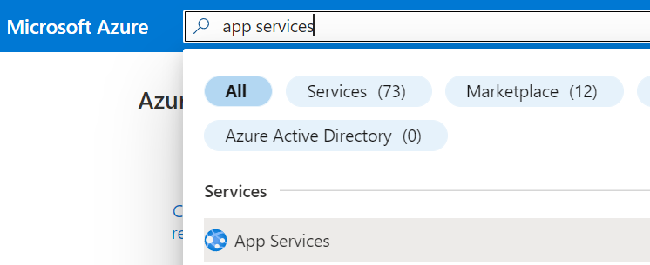
Follow these steps to create your App Service resources and publish your project:
Type app services in the search. Under Services, select App Services.
Notes:
Type app services in the search. Under Services, select App Services.

Slide 19
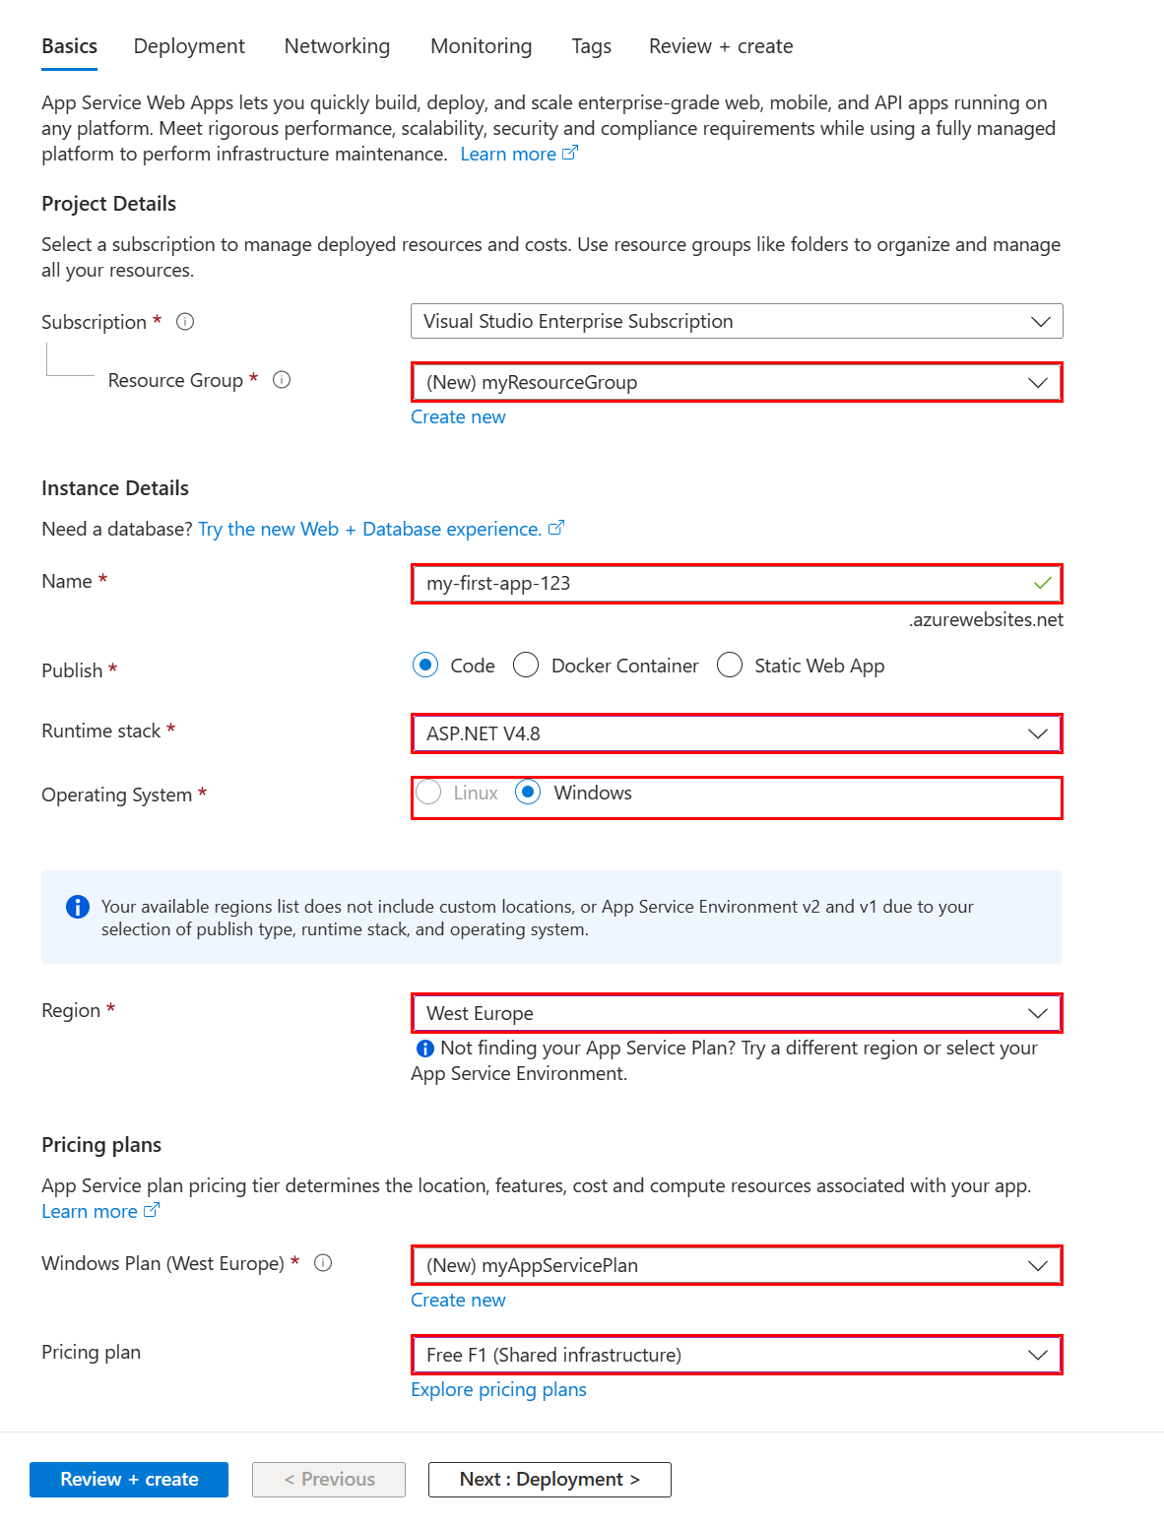
In the App Services page, select + Create.
In the Basics tab:
Under Resource group, select Create new. Type myResourceGroup for the name.
Under Name, type a globally unique name for your web app.
Under Publish, select Code.
Under Runtime stack select ASP.NET V4.8.
Select an Operating System, and a Region you want to serve your app from.
Under App Service Plan, select Create new and type myAppServicePlan for the name.
Under Pricing plan, select Free F1.
Notes:
In the App Services page, select + Create.
In the Basics tab:
Under Resource group, select Create new. Type myResourceGroup for the name.
Under Name, type a globally unique name for your web app.
Under Publish, select Code.
Under Runtime stack select ASP.NET V4.8.
Select an Operating System, and a Region you want to serve your app from.
Under App Service Plan, select Create new and type myAppServicePlan for the name.
Under Pricing plan, select Free F1.

Slide 20
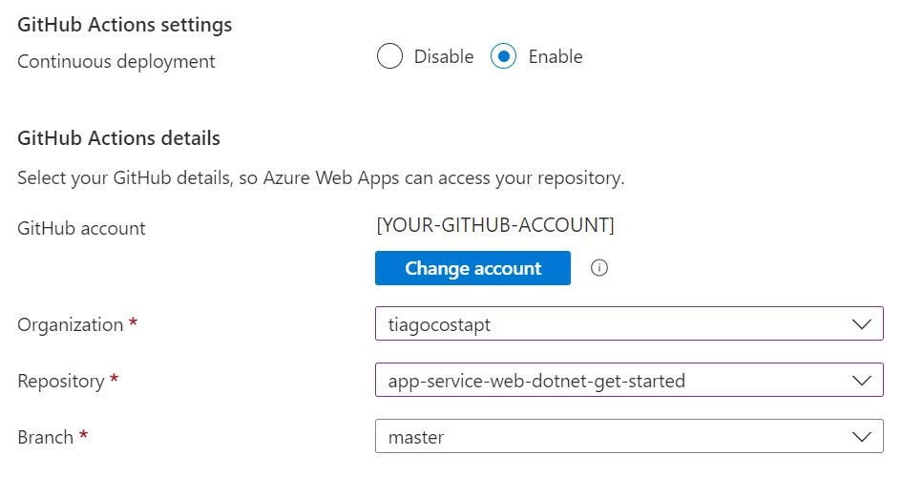
Select the Next: Deployment > button at the bottom of the page.
In the Deployment tab, under GitHub Actions settings make sure Continuous deployment is Enable.
Under GitHub Actions details, authenticate with your GitHub account, and select the following options:
For Organization select the organization where you have forked the demo project.
For Repository select the app-service-web-dotnet-get-started project.
For Branch select master.
Notes:
Select the Next: Deployment > button at the bottom of the page.
In the Deployment tab, under GitHub Actions settings make sure Continuous deployment is Enable.
Under GitHub Actions details, authenticate with your GitHub account, and select the following options:
For Organization select the organization where you have forked the demo project.
For Repository select the app-service-web-dotnet-get-started project.
For Branch select master.

Slide 21
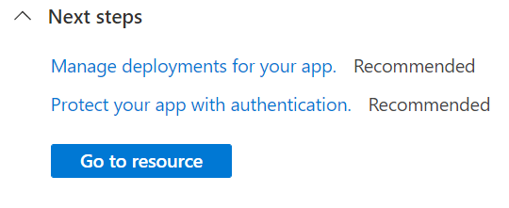
Select the Review + create button at the bottom of the page.
After validation runs, select the Create button at the bottom of the page.
After deployment is complete, select Go to resource.
Notes:
Select the Review + create button at the bottom of the page.
After validation runs, select the Create button at the bottom of the page.
After deployment is complete, select Go to resource.

Slide 22
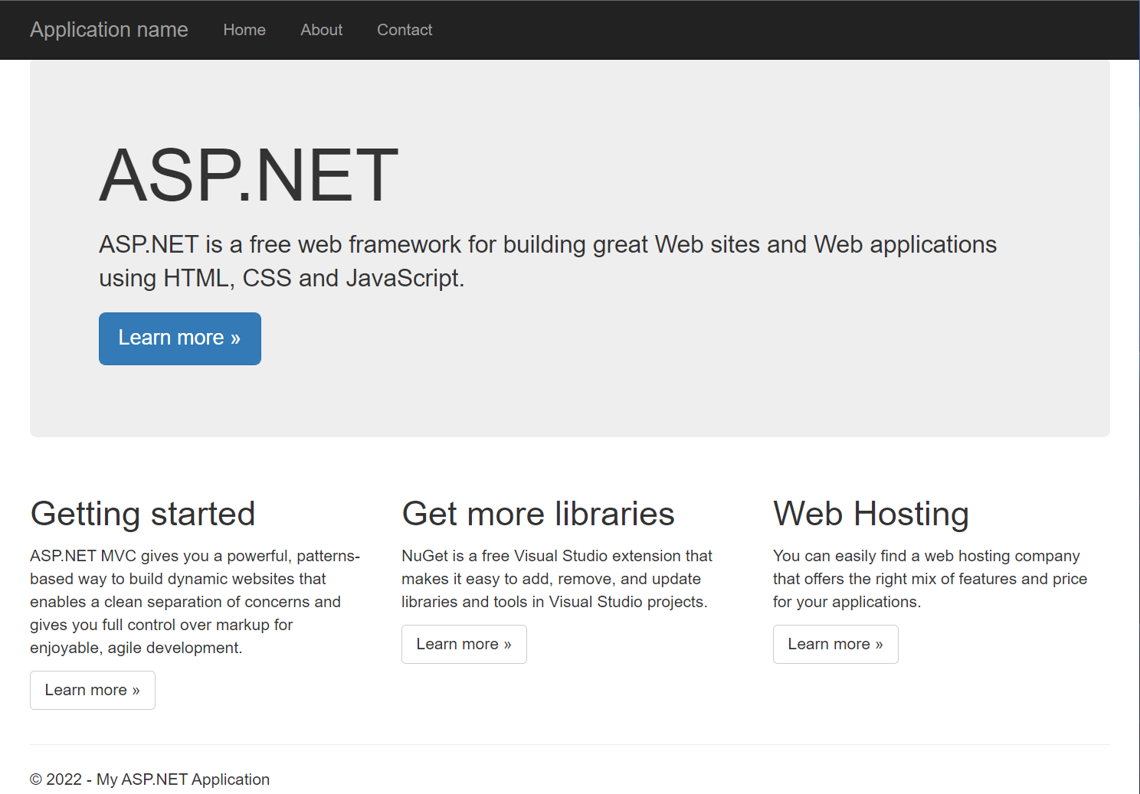
Browse to the deployed application in your web browser at the URL http://<app-name>.azurewebsites.net.
Notes:
Browse to the deployed application in your web browser at the URL http://<app-name>.azurewebsites.net.

Slide 23
Hands-On
Create a static HTML web app by using Azure Cloud Shell.
In this exercise, you'll deploy a basic HTML+CSS site to Azure App Service by using the Azure Command Line Interface.
We will then update the code and redeploy it by using the same command.
Notes:
In this exercise, we will Create a static HTML web app by using Azure Cloud Shell. You'll deploy a basic HTML+CSS site to Azure App Service by using the Azure Command Line Interface.
We will then update the code and redeploy it by using the same command.

Slide 24
Quiz
1. What are Azure App Services?
a) A cloud-based platform for running virtual machines in Azure
b) A service that provides domain registration and management
c) A fully managed platform for building, deploying, and scaling web applications
d) A service that allows you to manage your virtual networks in Azure
Answer: c) A fully managed platform for building, deploying, and scaling web applications
2. Which programming languages can be used to build applications on Azure App Services?
a) Only .NET languages (C#, VB.NET, etc.)
b) Python and Ruby
c) Any programming language that supports Docker containers
d) Any programming language that supports HTTP/HTTPS
Answer: d) Any programming language that supports HTTP/HTTPS

Slide 25
Quiz
3. How does Azure App Services support automatic scaling?
a) By automatically adding more virtual machines to the application
b) By adjusting the CPU and memory of the existing virtual machines
c) By replicating the application across multiple Azure regions
d) By dynamically adding or removing instances based on demand
Answer: d) By dynamically adding or removing instances based on demand
4. Which types of applications can be deployed on Azure App Services?
a) Only web applications
b) Only mobile applications
c) Both web and mobile applications
d) Only desktop applications
Answer: c) Both web and mobile applications

Slide 26
Quiz
5. What is the main advantage of using Azure App Services for application deployment?
a) It provides free domain registration for all deployed applications.
b) It automatically manages and maintains the underlying infrastructure.
c) It offers unlimited storage for application data.
d) It supports only Microsoft technologies and tools.
Answer: b) It automatically manages and maintains the underlying infrastructure.

Slide 27
Summary
Azure App Services is a fully managed platform provided by Microsoft Azure for building, deploying, and scaling web and mobile applications. It supports a wide range of programming languages and provides automatic scaling to handle varying workloads efficiently. The platform takes care of managing the underlying infrastructure, allowing developers to focus solely on application development. Azure App Services offer seamless integration with various Azure services, enabling developers to build powerful and feature-rich applications. With its ease of use, robust scalability, and automatic maintenance, Azure App Services streamline the deployment process and enhance the overall development experience in the cloud.
Notes:
We studied Azure App services, and their implementation in developing applications and hosting them in cloud. We also deployed to app service and , created a static HTML web app by using Azure Cloud Shell.

Slide 28
References
https://towardsdatascience.com/
https://en.wikipedia.org/wiki/Data_analysis
Explore Azure App Service - Learn | Microsoft Docs
https://data-flair.training/blogs/data-science-applications/
Azure Virtual Network (VNet) - Tutorials Dojo

Slide 29
Thank You

